Slide 1
BRIEF INTRODUCTION OF COMMON AI MODELS AND POTENTIAL APPLICATIONS
Ashok Dahal

Slide 2
What you will learn
Common statistical, machine and deep learning concepts
Linear regression
Logistic regression
Baysian model
Convolutional neural network (CNN)
Recurrent neural network (RNN)

Slide 3
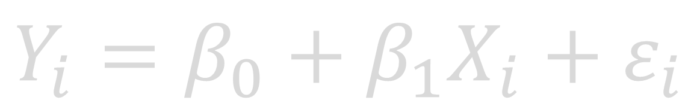
Linear Regression
Basic approach for data driven modelling
Use linear equation to model relation between independent and dependent variables
$$Y_{i}=β_{0}+β_{1}X_{i}+ε_{i}$$

Slide 4
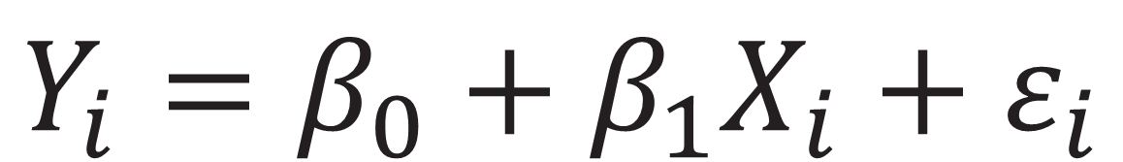
Linear Regression
Basic approach for data driven modelling
Use linear equation to model relation between independent and dependent variables
$$Y_{i}=β_{0}+β_{1}X_{i}+ε_{i}$$

Slide 5
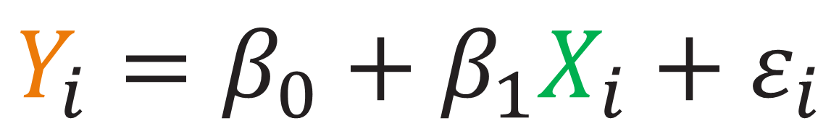
Linear Regression
Basic approach for data driven modelling
Use linear equation to model relation between independent and dependent variables
Dependent variable
Inependent variable(s)
$$Y_{i}=β_{0}+β_{1}X_{i}+ε_{i}$$

Slide 6
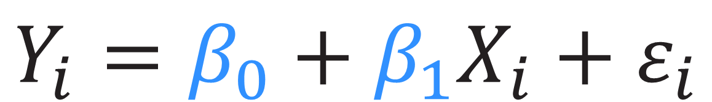
Linear Regression
Basic approach for data driven modelling
Use linear equation to model relation between independent and dependent variables
Coefficients
$$Y_{i}=β_{0}+β_{1}X_{i}+ε_{i}$$

Slide 7
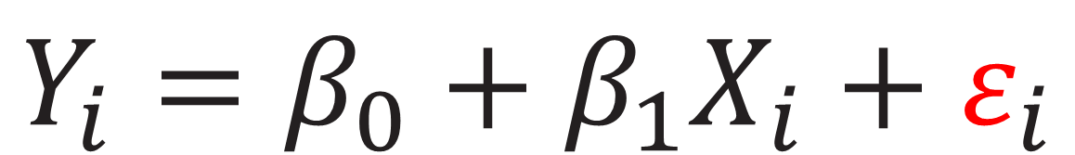
Linear Regression
Basic approach for data driven modelling
Use linear equation to model relation between independent and dependent variables
Error
$$Y_{i}=β_{0}+β_{1}X_{i}+ε_{i}$$

Slide 8
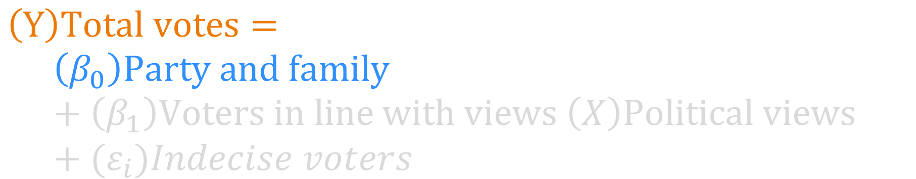
Linear Regression
$$\left(Y\right)Total votes=$$
$$\left(β_{0}\right)Party and family +\left(β_{1}\right)Voters in line with views \left(X\right)Political views+{(ε}_{i})Indecise voters$$

Slide 9
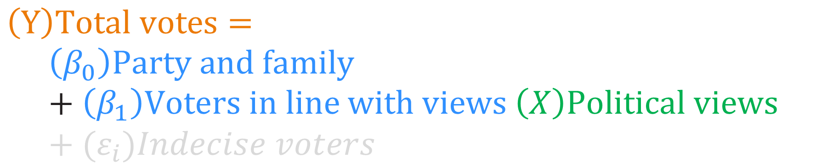
Linear Regression
$$\left(Y\right)Total votes=$$
$$\left(β_{0}\right)Party and family +\left(β_{1}\right)Voters in line with views \left(X\right)Political views+{(ε}_{i})Indecise voters$$

Slide 10
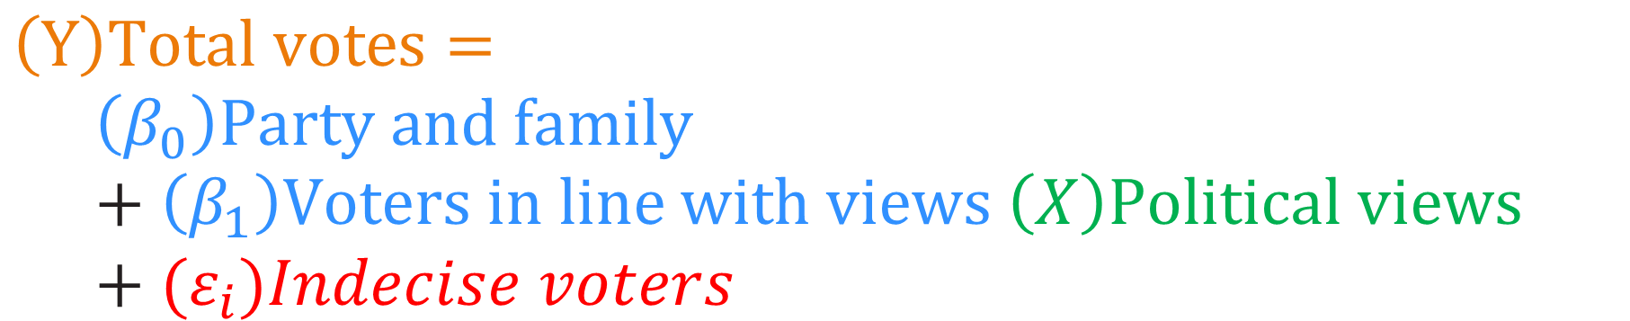
Linear Regression
$$\left(Y\right)Total votes=$$
$$\left(β_{0}\right)Party and family +\left(β_{1}\right)Voters in line with views \left(X\right)Political views+{(ε}_{i})Indecise voters$$

Slide 11
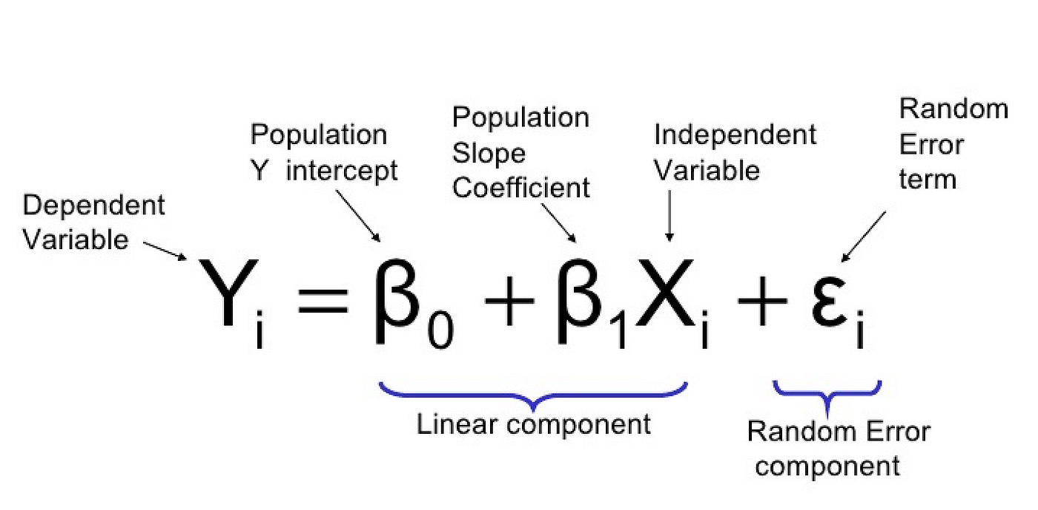
Linear Regression
Source: https://towardsdatascience.com/linear-regression-in-python-9a1f5f000606

Slide 12
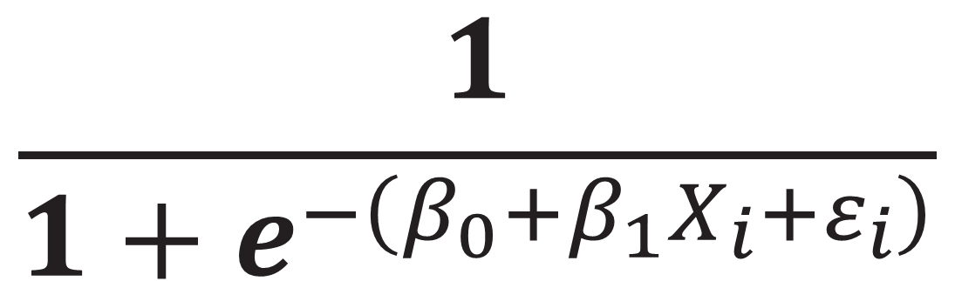
LOGISTIC Regression
Used for binary classification tasks
Use logistic equation to model probability of event occurrences
$$\frac{1}{1+e^{−\left(β_{0}+β_{1}X_{i}+ε_{i}\right)}}$$

Slide 13
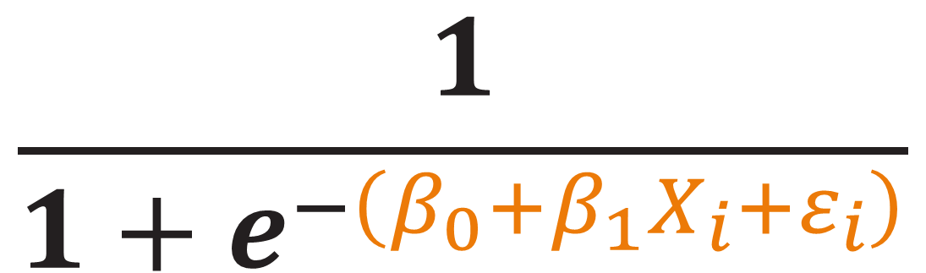
Logistic Regression
Used for binary classification tasks
Use logistic equation to model probability of event occurrences
$$\frac{1}{1+e^{−\left(β_{0}+β_{1}X_{i}+ε_{i}\right)}}$$
Linear regression equation

Slide 14
Logistic Regression
y
1
p
0
x
Source: based on https://www.saedsayad.com/logistic_regression.htm

Slide 15
Logistic Regression
y
1
p
0
x
Source: based on https://www.saedsayad.com/logistic_regression.htm

Slide 16
Logistic Regression
y
1
p
0
x
Source: based on https://www.saedsayad.com/logistic_regression.htm

Slide 17
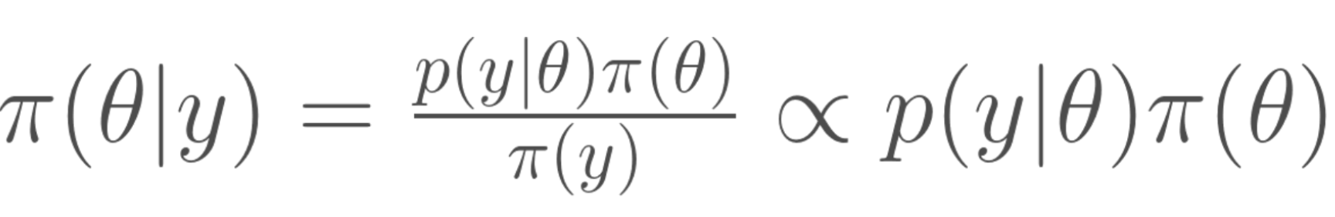
Baysian model
Parameters are random variables with distributions
Predictions show a range of outcomes
Accounts for uncertainty in estimates rather than providing a single prediction

Slide 18
Baysian model
Parameters are random variables with distributions
Predictions show a range of outcomes
Accounts for uncertainty in estimates rather than providing a single prediction

Slide 19
Baysian model
INITIAL
BELIEF
A
POSTERIORI
LIKELIHOOD
DATA
A
PRIORI
Source: based on https://freshbiostats.wordpress.com/2013/01/11/introduction-to-bayesian-statistics-2/,

Slide 20
Baysian model
INITIAL
BELIEF
A
POSTERIORI
LIKELIHOOD
DATA
A
PRIORI
Source: based on https://freshbiostats.wordpress.com/2013/01/11/introduction-to-bayesian-statistics-2/,

Slide 21
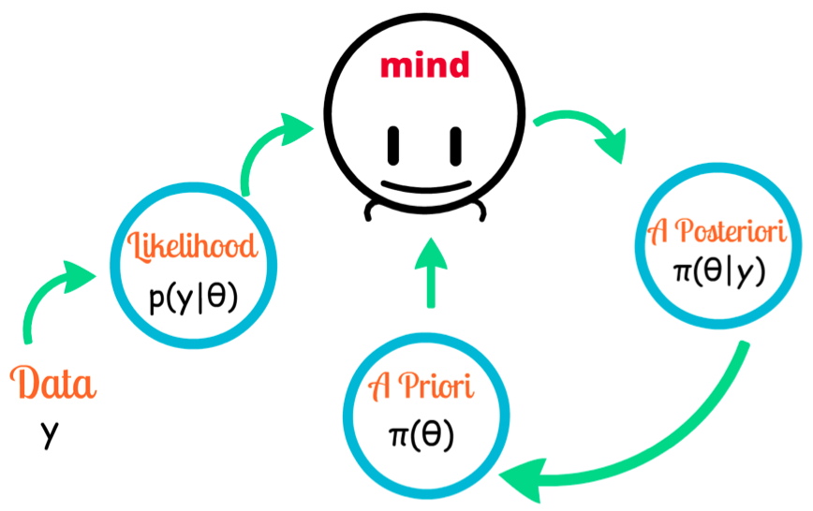
Baysian Model
https://freshbiostats.wordpress.com/2013/01/11/introduction-to-bayesian-statistics-2/,

Slide 22
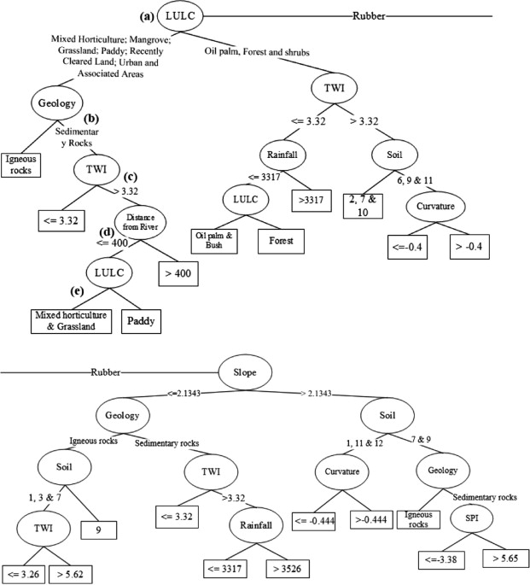
Decision trees
https://www-sciencedirect-com.ezproxy2.utwente.nl/science/article/pii/S0022169413006872#f0020

Slide 23
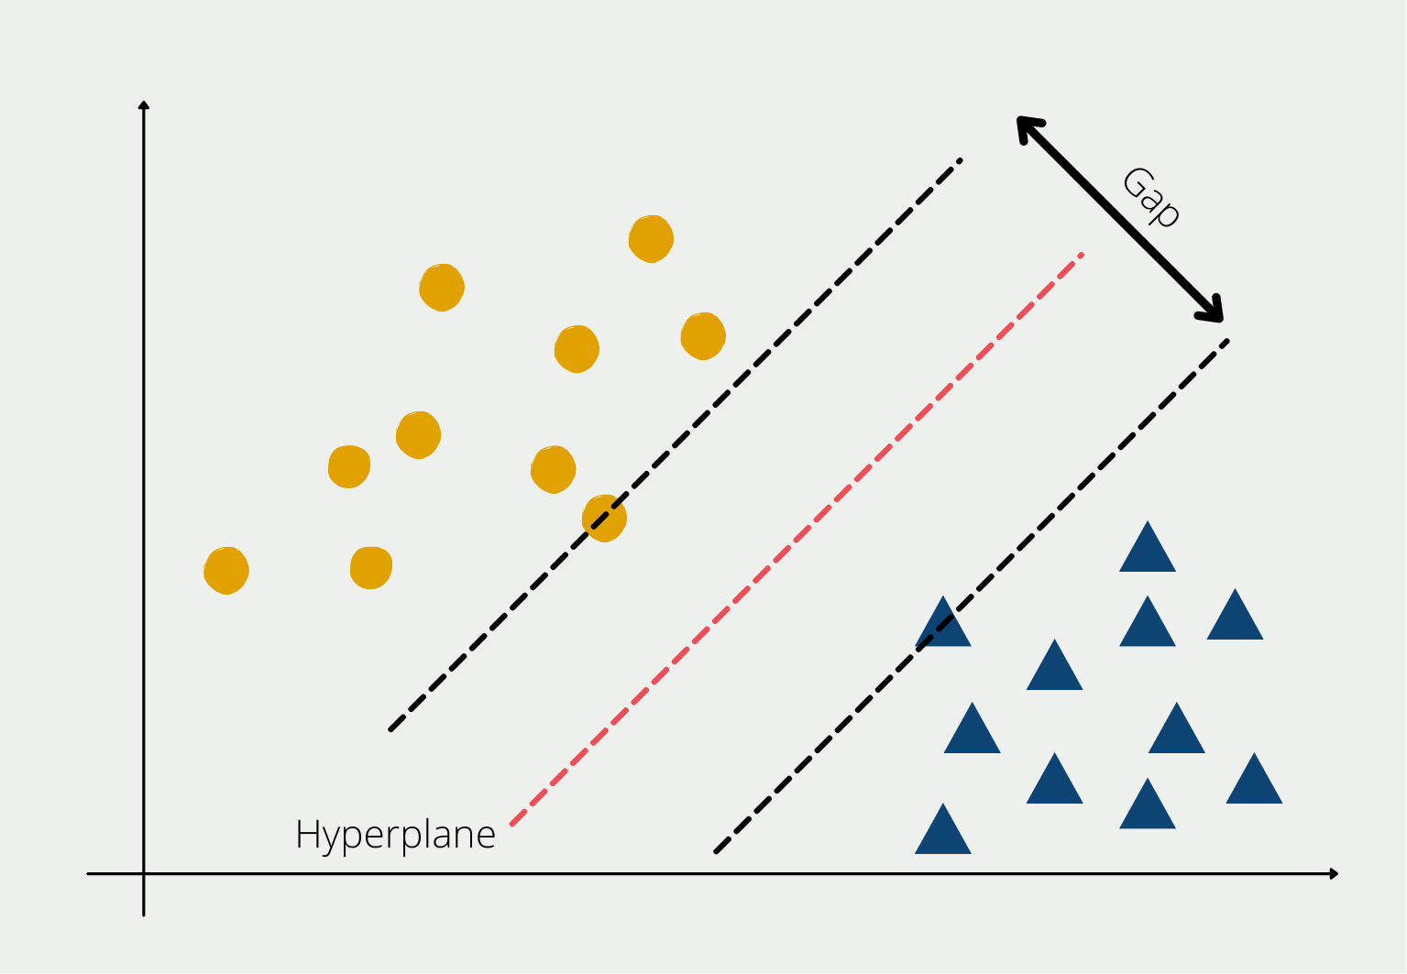
Support Vector Machine
https://databasecamp.de/en/ml/svm-explained

Slide 24
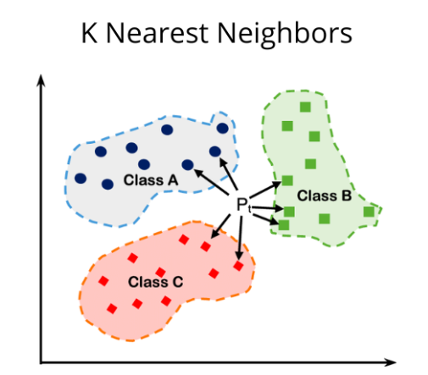
KNN
https://medium.com/@sachinsoni600517/k-nearest-neighbours-introduction-to-machine-learning-algorithms-9dbc9d9fb3b2

Slide 25

Convolutional neural network
cnn

Slide 26
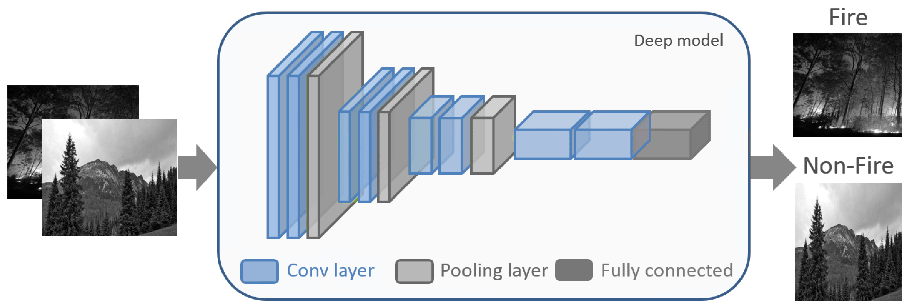
Convolutional neural network
cnn
Source: https://www.mdpi.com/2072-4292/15/7/1821

Slide 27
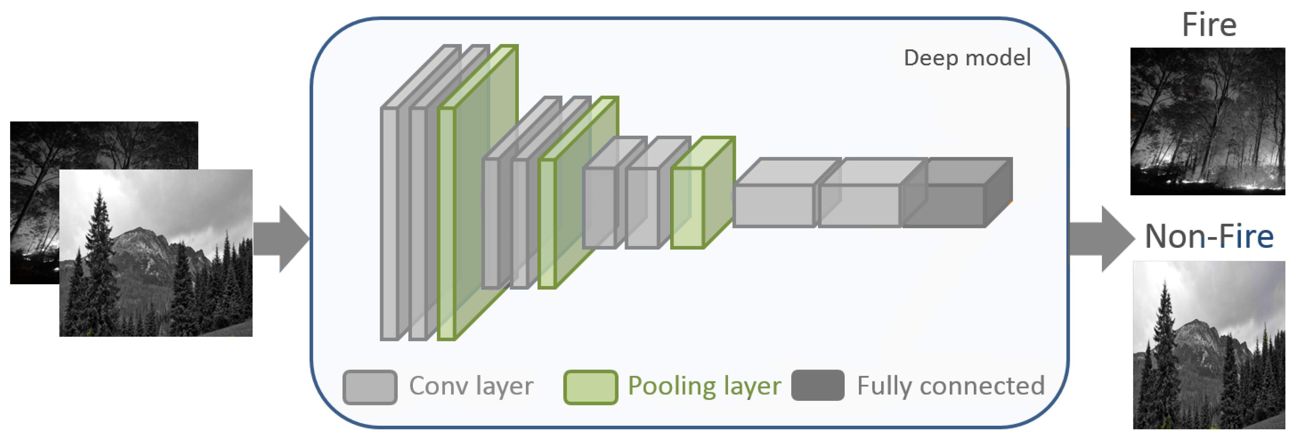
Convolutional neural network
cnn
Source: https://www.mdpi.com/2072-4292/15/7/1821

Slide 28
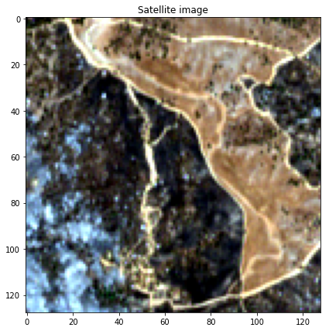
Convolutional neural network
cnn

Slide 29
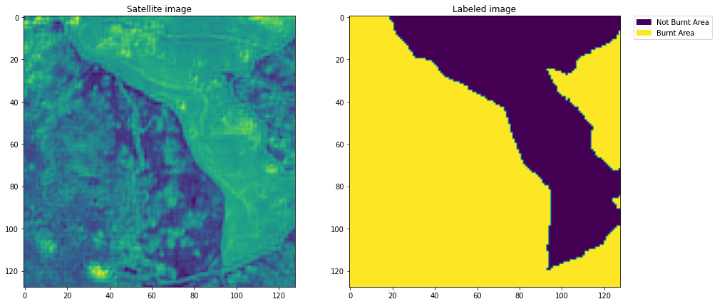
Convolutional neural network
cnn

Slide 30
Convolutional neural network
cnn
Burnt area
Not burnt area

Slide 31
Recurrent neural network and transformers
RNNs
Handle sequential data, capturing temporal dependencies through directed cycles
E.g., precipitation forecasting, text translation, voice recognition
Process sequential data step by step, identifying patterns
E.g., can identify earthquake precursors
Transformers
A newer architecture that excel at analyzing entire sequences at once, capturing long-range dependencies
Transformers can identify complex relationships and patterns
E.g., subtle correlations between signals from different locations
1
2
3

Slide 32
Recurrent neural network and transformers
RNNs
Handle sequential data, capturing temporal dependencies through directed cycles
E.g., precipitation forecasting, text translation, voice recognition
Process sequential data step by step, identifying patterns
E.g., can identify earthquake precursors
Transformers
A newer architecture that excel at analyzing entire sequences at once, capturing long-range dependencies
Transformers can identify complex relationships and patterns
E.g., subtle correlations between signals from different locations
1
2
3

Slide 33
Recurrent neural network and transformers
RNNs
Handle sequential data, capturing temporal dependencies through directed cycles
E.g., precipitation forecasting, text translation, voice recognition
Process sequential data step by step, identifying patterns
E.g., can identify earthquake precursors
Transformers
A newer architecture that excel at analyzing entire sequences at once, capturing long-range dependencies
Transformers can identify complex relationships and patterns
E.g., subtle correlations between signals from different locations
1
2
3

Slide 34
Recurrent neural network and transformers
RNNs
Handle sequential data, capturing temporal dependencies through directed cycles
E.g., precipitation forecasting, text translation, voice recognition
Process sequential data step by step, identifying patterns
E.g., can identify earthquake precursors
Transformers
A newer architecture that excel at analyzing entire sequences at once, capturing long-range dependencies
Transformers can identify complex relationships and patterns
E.g., subtle correlations between signals from different locations
1
2
3

Slide 35
Recurrent neural network and transformers
RNNs
Handle sequential data, capturing temporal dependencies through directed cycles
Common applications: precipitation forecasting, text translation, voice recognition
Process sequential data step by step, identifying patterns
E.g., can identify earthquake precursors
Transformers
A newer architecture that excel at analyzing entire sequences at once, capturing long-range dependencies
Transformers can identify complex relationships and patterns
E.g., subtle correlations between signals from different locations
1
2
3

Slide 36
Recurrent neural network and transformers
RNNs
Handle sequential data, capturing temporal dependencies through directed cycles
Common applications: precipitation forecasting, text translation, voice recognition
Process sequential data step by step, identifying patterns
E.g., can identify earthquake precursors
Transformers
A newer architecture that excel at analyzing entire sequences at once, capturing long-range dependencies
Transformers can identify complex relationships and patterns
E.g., subtle correlations between signals from different locations
1
2
3

Slide 37
Recurrent neural network and transformers
RNNs
Handle sequential data, capturing temporal dependencies through directed cycles
Common applications: precipitation forecasting, text translation, voice recognition
Process sequential data step by step, identifying patterns
E.g., can identify earthquake precursors
Transformers
A newer architecture that excel at analyzing entire sequences at once, capturing long-range dependencies
Transformers can identify complex relationships and patterns
E.g., subtle correlations between signals from different locations
1
2
3

Slide 38
Recurrent neural network and transformers
Both RNNs and Transformers offer valuable but different insights into seismic signal analysis.
RNNs focus on short-term patterns.
Transformers focus on global, long-term patterns.

Slide 39
Recurrent neural network and transformers
Both RNNs and Transformers offer valuable but different insights into seismic signal analysis.
RNNs focus on short-term patterns.
Transformers focus on global, long-term patterns.

Slide 40
Recurrent neural network and transformers
Both RNNs and Transformers offer valuable but different insights into seismic signal analysis.
RNNs focus on short-term patterns.
Transformers focus on global, long-term patterns.

Slide 41
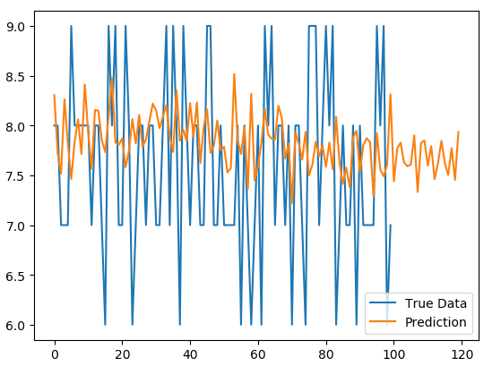
Recurrent neural network
True Data
Prediction
Source: https://github.com/256ericpan/LSTM_IoT

